Slide 1
CSC 2310 Object Oriented Programming & Design
Dr. Shah Alam

Slide 2
Objects and Methods
Java is an object-oriented programming (O O P) language
Programming methodology that views a program as consisting of objects that interact with one another by means of actions (called methods)
Objects of the same kind are said to have the same type or be in the same class

Slide 3
Terminology Comparisons
Other high-level languages have constructs called procedures, methods, functions, and/or subprograms
These types of constructs are called methods in Java
All programming constructs in Java, including methods, are part of a class

Slide 4
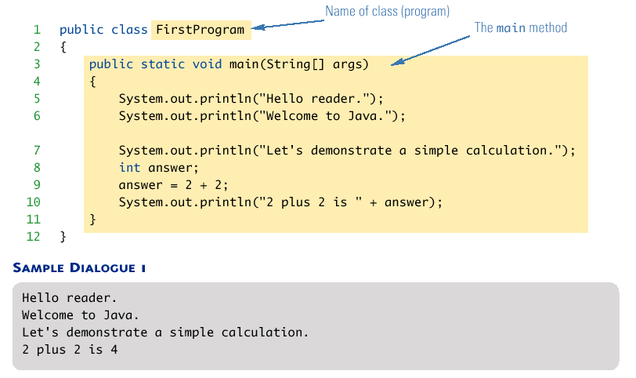
A Sample Java Application Program
Display 1.1 A sample java Program

Slide 5
System.out.println (1 of 2)
Java programs work by having things called objects perform actions
System.out: An object used for sending output to the screen
The actions performed by an object are called methods
Printl n: The method or action that the System.out object performs

Slide 6
System.out.printl n (2 of 2)
Invoking or calling a method: When an object performs an action using a method
Also called sending a message to the object
Method invocation syntax (in order): an object, a dot (period), the method name, and a pair of parentheses
Arguments: Zero or more pieces of information needed by the method that are placed inside the parentheses

Slide 7

Variable declarations
Variable declarations in Java are similar to those in other programming languages
Simply give the type of the variable followed by its name and a semicolon

Slide 8

Using = and +
In Java, the equal sign (=) is used as the assignment operator
The variable on the left side of the assignment operator is assigned the value of the expression on the right side of the assignment operator
In Java, the plus sign (+) can be used to denote addition (as above) or concatenation
Using +, two strings can be connected together

Slide 9
Computer Language Levels (1 of 2)
High-level language: A language that people can read, write, and understand
A program written in a high-level language must be translated into a language that can be understood by a computer before it can be run
Machine language: A language that a computer can understand

Slide 10
Computer Language Levels (2 of 2)
Low-level language: Machine language or any language similar to machine language
Compiler: A program that translates a high-level language program into an equivalent low-level language program
This translation process is called compiling

Slide 11
Byte-Code and the Java Virtual Machine (1 of 2)
The compilers for most programming languages translate high-level programs directly into the machine language for a particular computer
Since different computers have different machine languages, a different compiler is needed for each one
In contrast, the Java compiler translates Java programs into byte-code, a machine language for a fictitious computer called the Java Virtual Machine
Once compiled to byte-code, a Java program can be used on any computer, making it very portable

Slide 12
Byte-Code and the Java Virtual Machine (2 of 2)
Interpreter: The program that translates a program written in Java byte-code into the machine language for a particular computer when a Java program is executed
The interpreter translates and immediately executes each byte-code instruction, one after another
Translating byte-code into machine code is relatively easy compared to the initial compilation step

Slide 13
Program terminology
Code: A program or a part of a program
Source code (or source program): A program written in a high-level language such as Java
The input to the compiler program
Object code: The translated low-level program
The output from the compiler program, e.g., Java byte-code
In the case of Java byte-code, the input to the Java byte-code interpreter

Slide 14
Class Loader
Java programs are divided into smaller parts called classes
Each class definition is normally in a separate file and compiled separately
Class Loader: A program that connects the byte-code of the classes needed to run a Java program
In other programming languages, the corresponding program is called a linker

Slide 15


Compiling a Java Program or Class
Each class definition must be in a file whose name is the same as the class name followed by .java
The class FirstProgram must be in a file named FirstProgram.java
Each class is compiled with the command javac followed by the name of the file in which the class resides
The result is a byte-code program whose filename is the same as the class name followed by .class

Slide 16

Running a Java Program
A Java program can be given the run command (java) after all its classes have been compiled
Only run the class that contains the main method (the system will automatically load and run the other classes, if any)
The main method begins with the line:
Follow the run command by the name of the class only (no .java or .class extension)

Slide 17
Syntax and Semantics
Syntax: The arrangement of words and punctuations that are legal in a language, the grammar rules of a language
Semantics: The meaning of things written while following the syntax rules of a Language

Slide 18
Tip: Error Messages (1 of 2)
Bug: A mistake in a program
The process of eliminating bugs is called debugging
Syntax error: A grammatical mistake in a program
The compiler can detect these errors, and will output an error message saying what it thinks the error is, and where it thinks the error is

Slide 19
Tip: Error Messages (2 of 2)
Run-time error: An error that is not detected until a program is run
The compiler cannot detect these errors: an error message is not generated after compilation, but after execution
Logic error: A mistake in the underlying algorithm for a program
The compiler cannot detect these errors, and no error message is generated after compilation or execution, but the program does not do what it is supposed to do

Slide 20
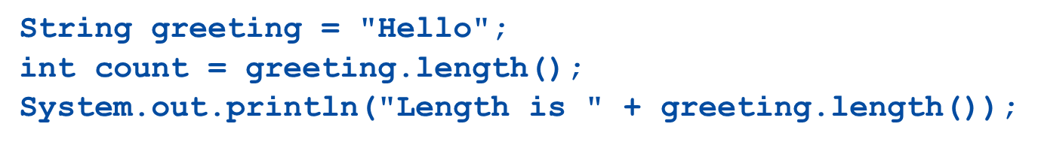
String Methods (1 of 10)
The String class contains many useful methods for string-processing applications
A String method is called by writing a String object, a dot, the name of the method, and a pair of parentheses to enclose any arguments
If a String method returns a value, then it can be placed anywhere that a value of its type can be used
Always count from zero when referring to the position or index of a character in a string

Slide 21
Not For Exams

Slide 22
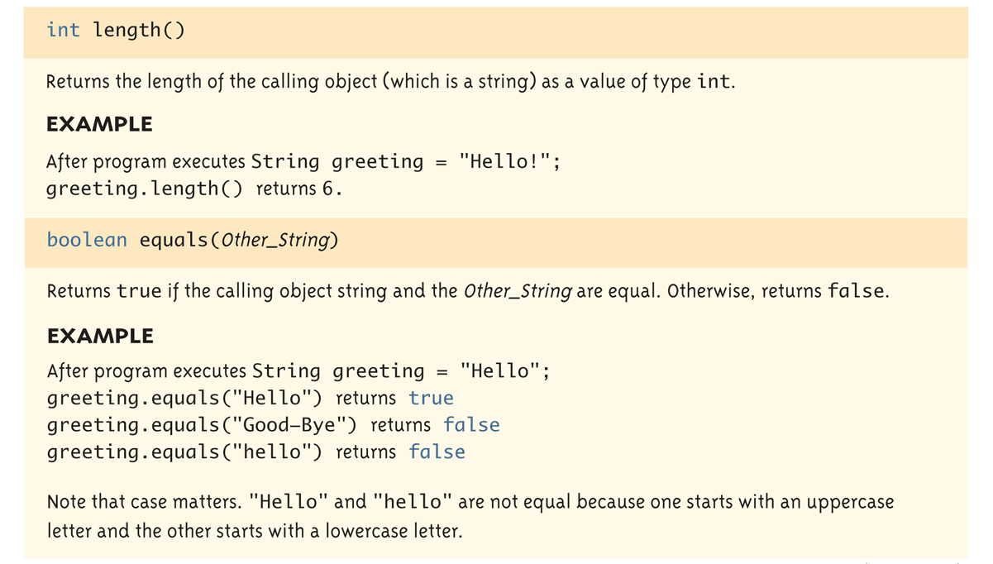
String Methods (2 of 10)
Display 1.4 Some Methods in the class String

Slide 23
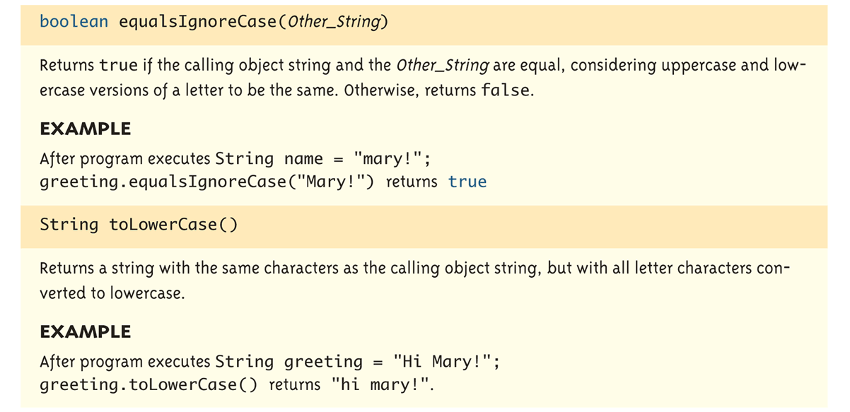
String Methods (3 of 10)
Display 1.4 Some Methods in the class String

Slide 24
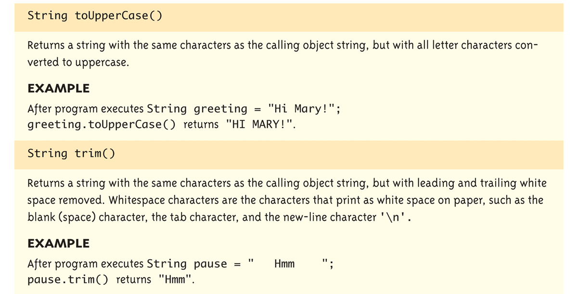
String Methods (4 of 10)
Display 1.4 Some Methods in the class String

Slide 25
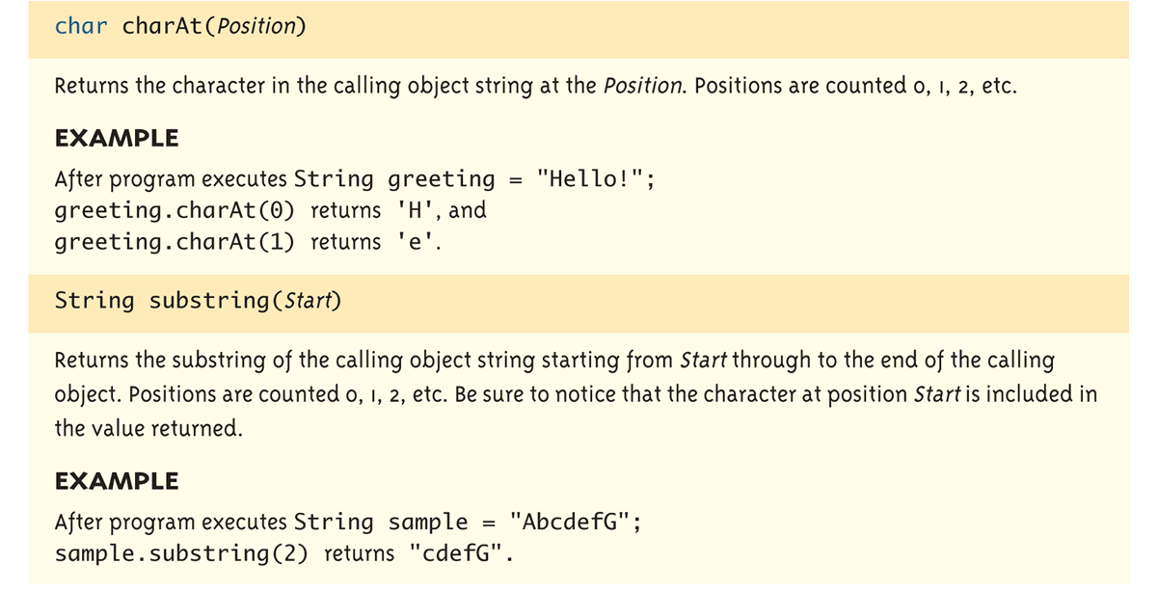
String Methods (5 of 10)
Display 1.4 Some Methods in the class String

Slide 26
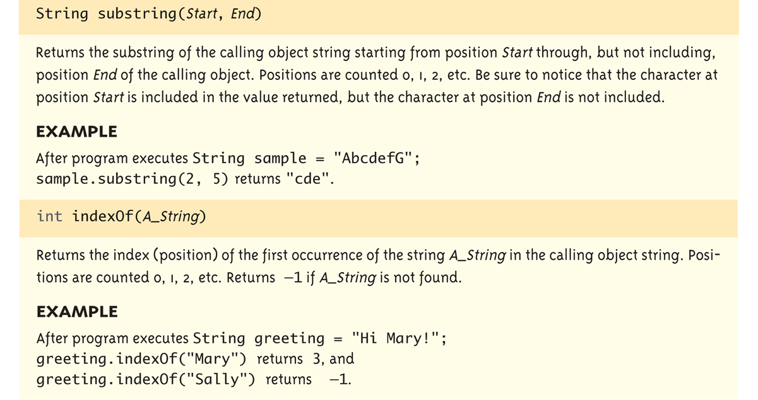
String Methods (6 of 10)
Display 1.4 Some Methods in the class String

Slide 27
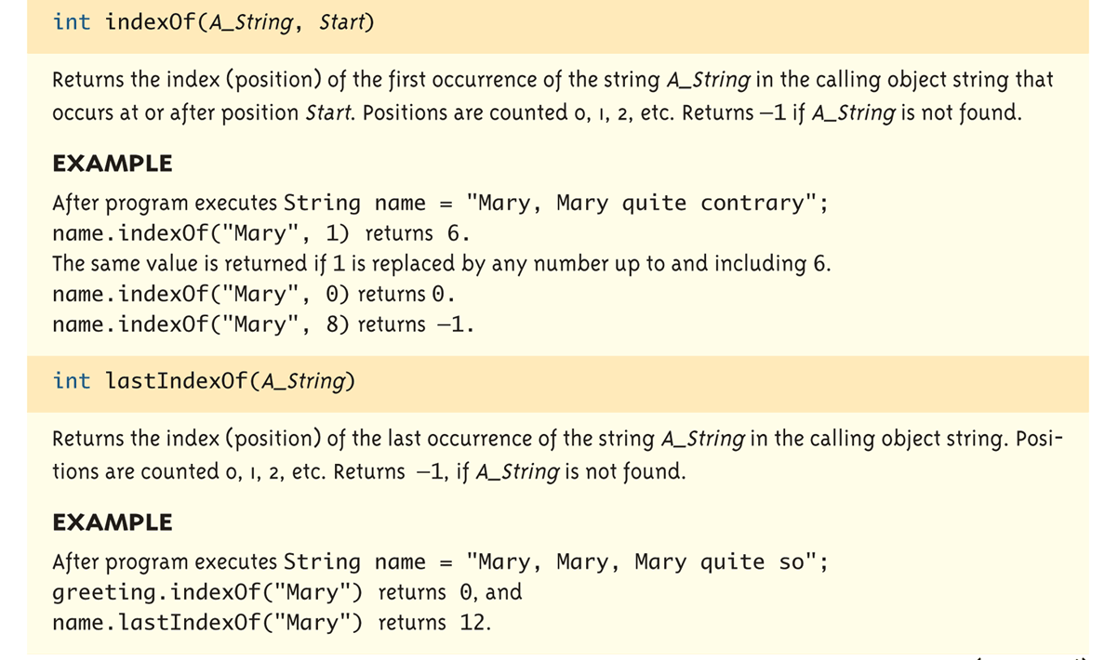
String Methods (7 of 10)
Display 1.4 Some Methods in the class String

Slide 28
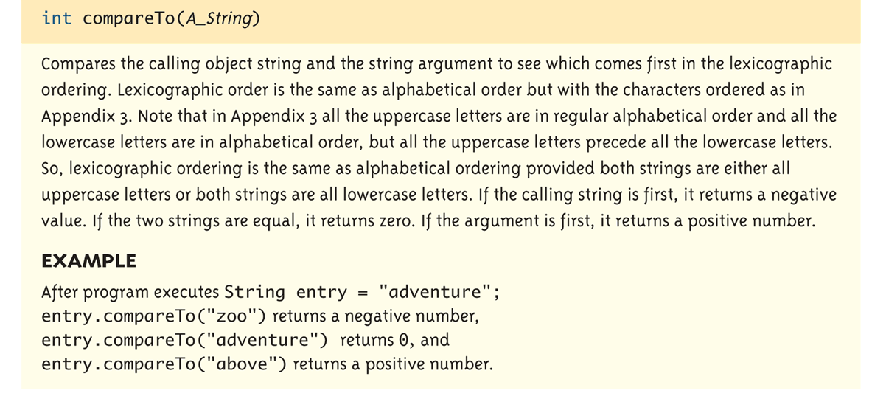
String Methods (8 of 10)
Display 1.4 Some Methods in the class String

Slide 29
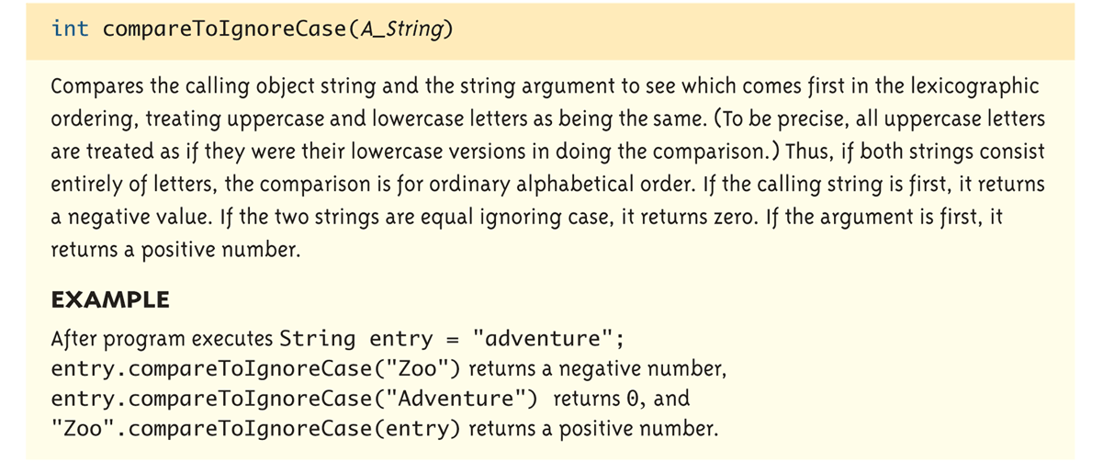
String Methods (9 of 10)
Display 1.4 Some Methods in the class String

Slide 30
Practice

Slide 31
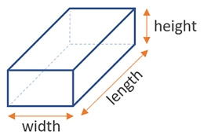
Write a java program that calculates the area and volume of a box.

Slide 32
Step 1
Write the basic structure of a java program
Create a class for the main program, usually it’s named as PurposeDriver or PurposeTest.
This class must be public
Write the main method
public static void main(String[]args)
Step 2
Define all the required objects in separate classes (not necessarily in the .java file)
Here, create a class for the Box object
define all the attributes (i.e., data such as length, width and height) and methods (such as area(), volume() etc., )
Attributes are usually private (highly recommended) and methods are public

Slide 33
Step 3
Create all necessary objects (i.e., Box) in the main method
Use the keyword “new” to create an object out of a class
Call relevant methods defined earlier (i.e., area(), volume() )

